Slide 1
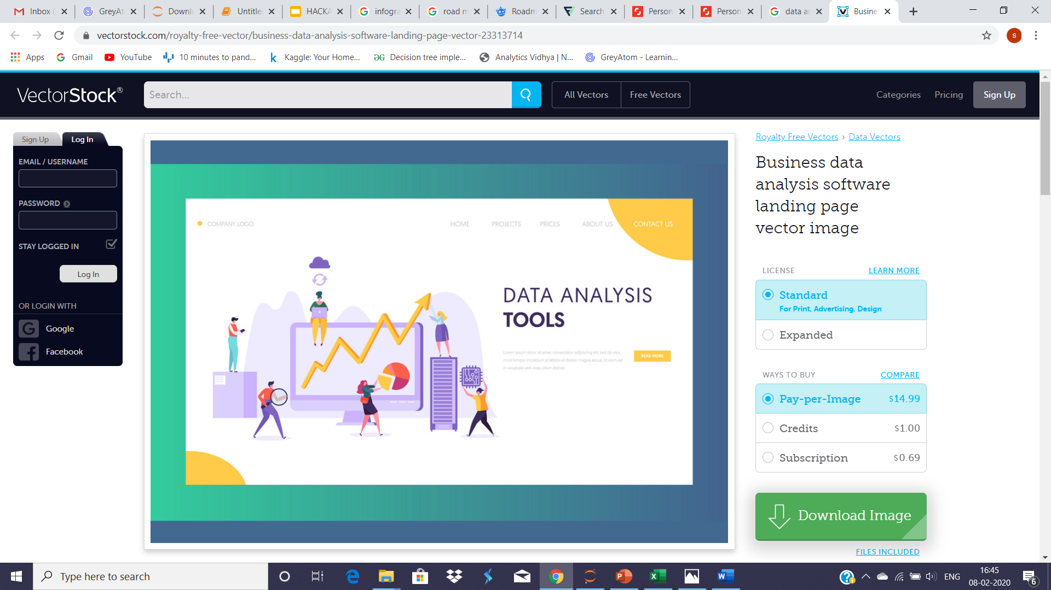
HACKATHON – 2 Credit Card Consumption Prediction
TEAM - NSVD
Dashang Makwana
Nevina Dalal
Simran Mulani
Vishakha Singh

Slide 2
Problem Statement
Common Man Bank wants to introduce offers and plans for the upcoming quarter based on the expenditures of their customers in the previous quarter, based on the demographics given we were asked to predict the average spend for the next three months.

Slide 3
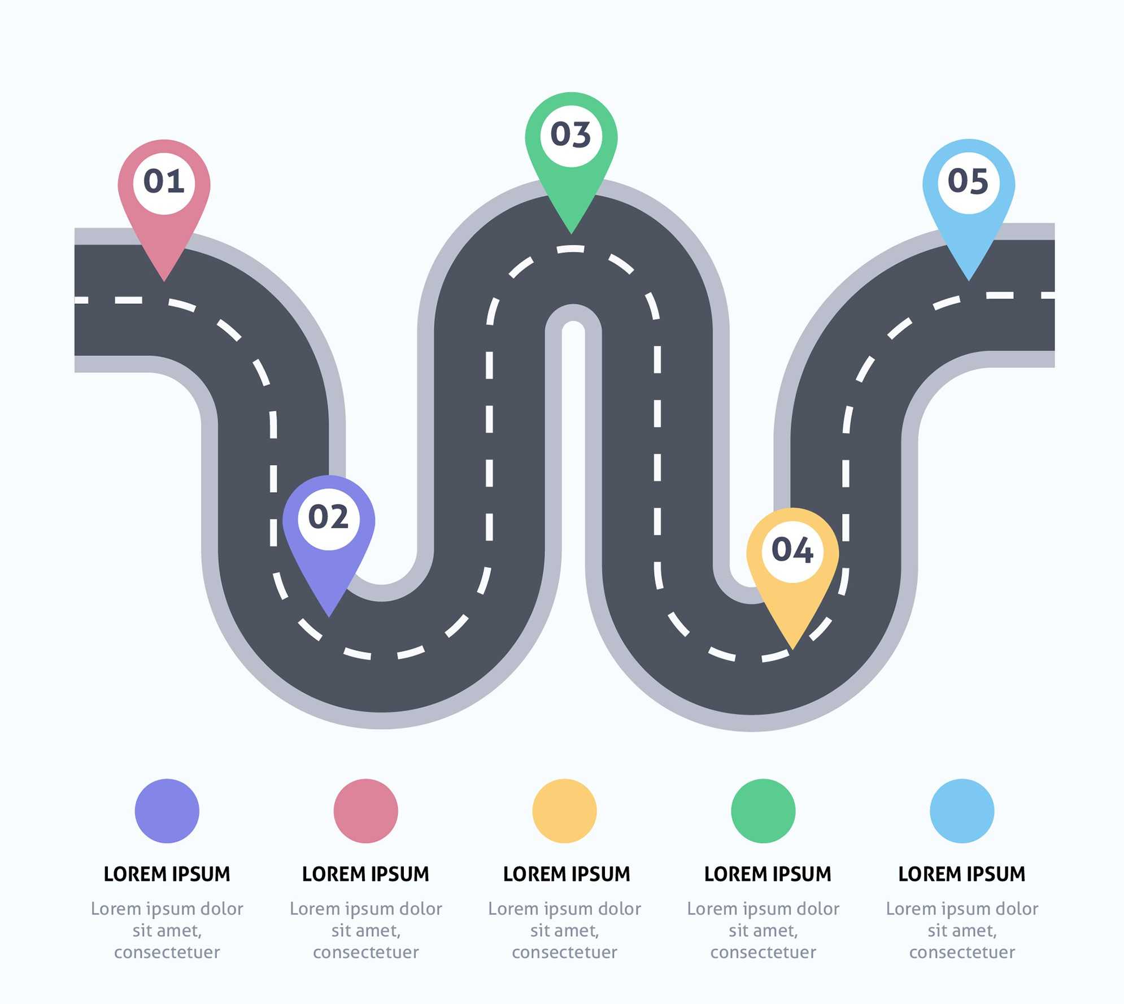
Our Approach
Outlier Treatment
EDA
Feature Selection
Baseline Model
Model Comparison

Slide 4
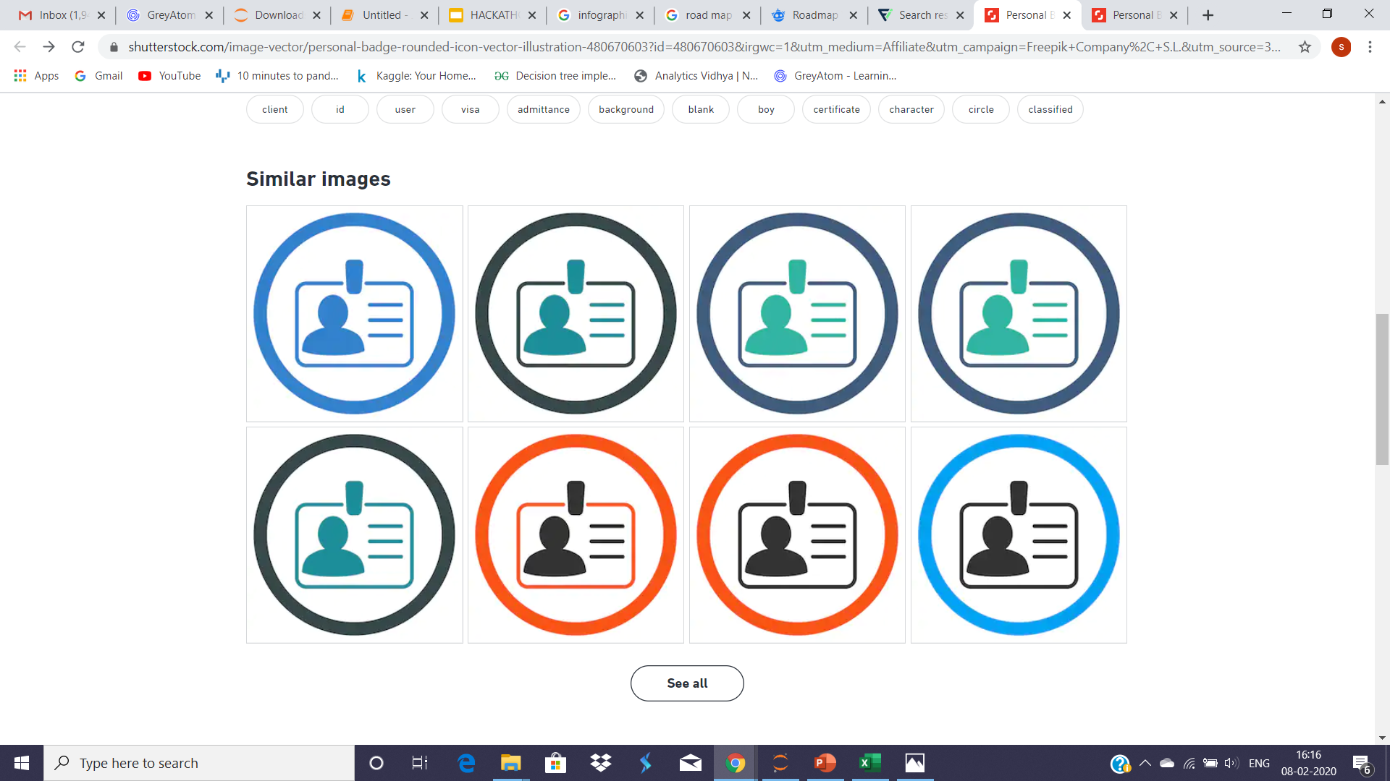
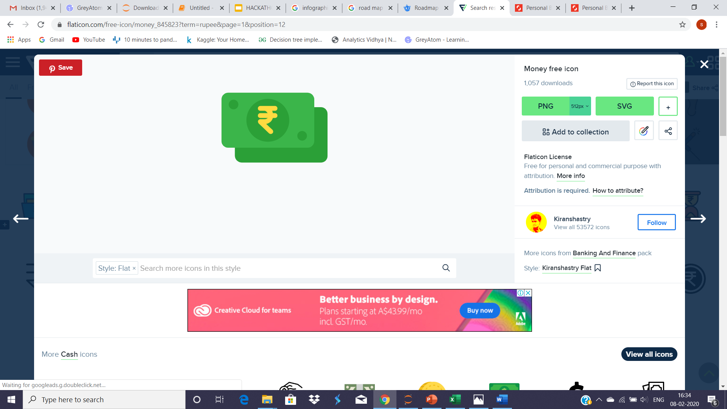
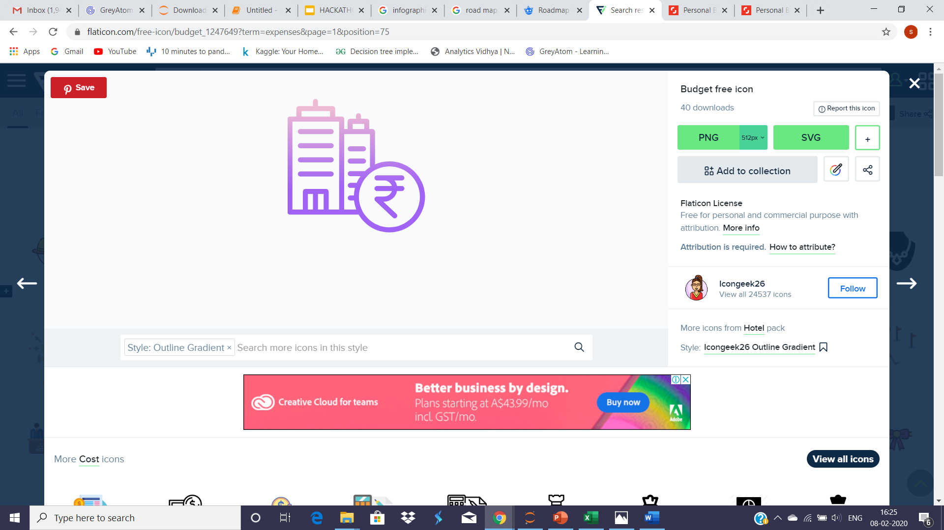
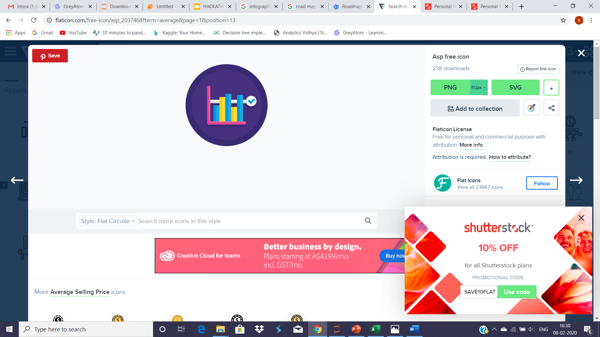
Datasets
We were provided with train and test datasets with the following demographics:
Credentials & Personal Info Expenditures
Loans & Investment Average Credit Card
Consumption

Slide 5
Preprocessing
Removed Outliers using winsorize
Binned age groups for better visualization
Removed region code because it had discrete value and it showed that it doesn't affect the target variable
Label encoded the remaining categorical variables so that regression model can take them as values
Used Standard Scalar on the X column so that all the variable get standardized with mean=0 and standard deviation = 1

Slide 6
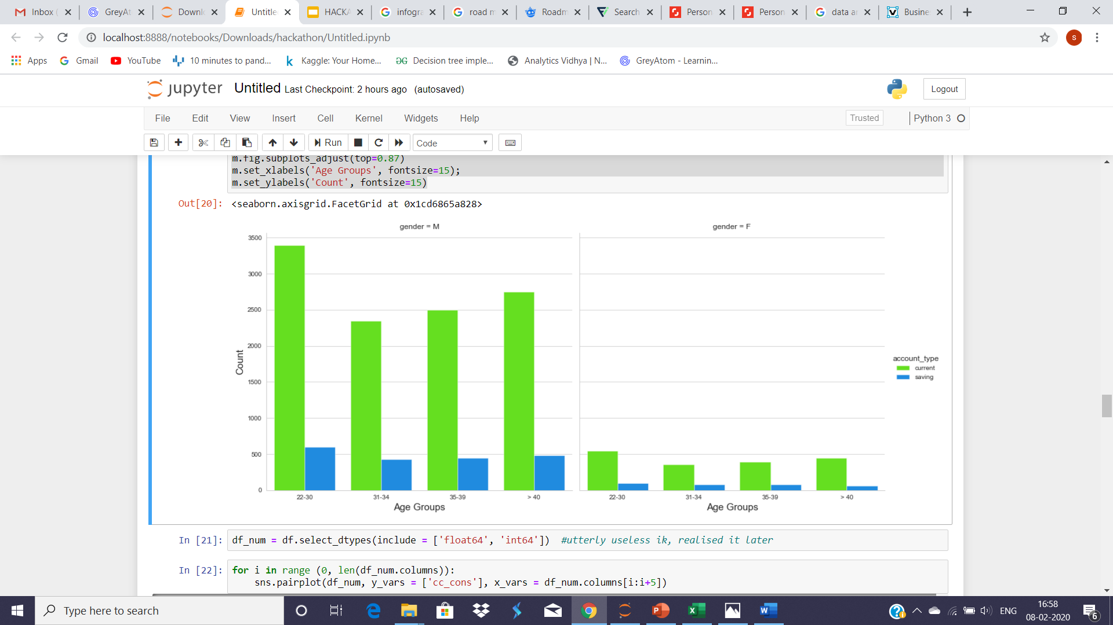
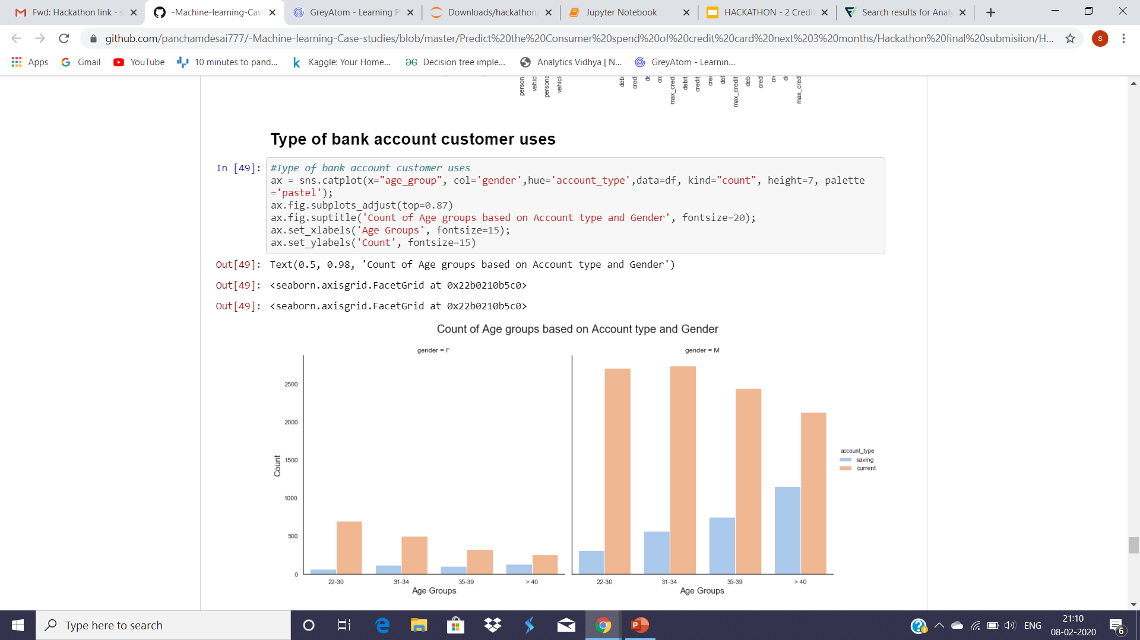
EDA

Slide 7
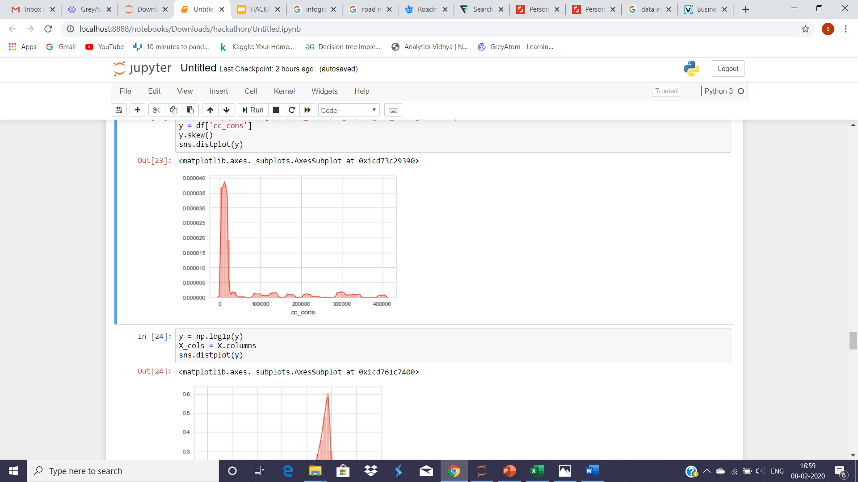

Correlation and it’s Normalised Form

Slide 8
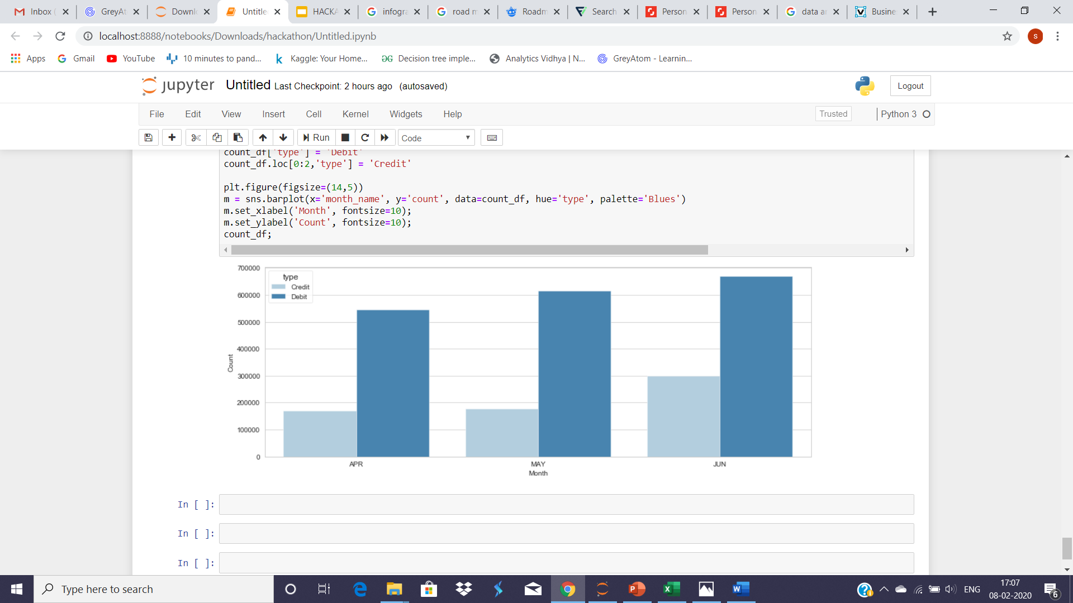
Debit and Credit Card Usage

Slide 9
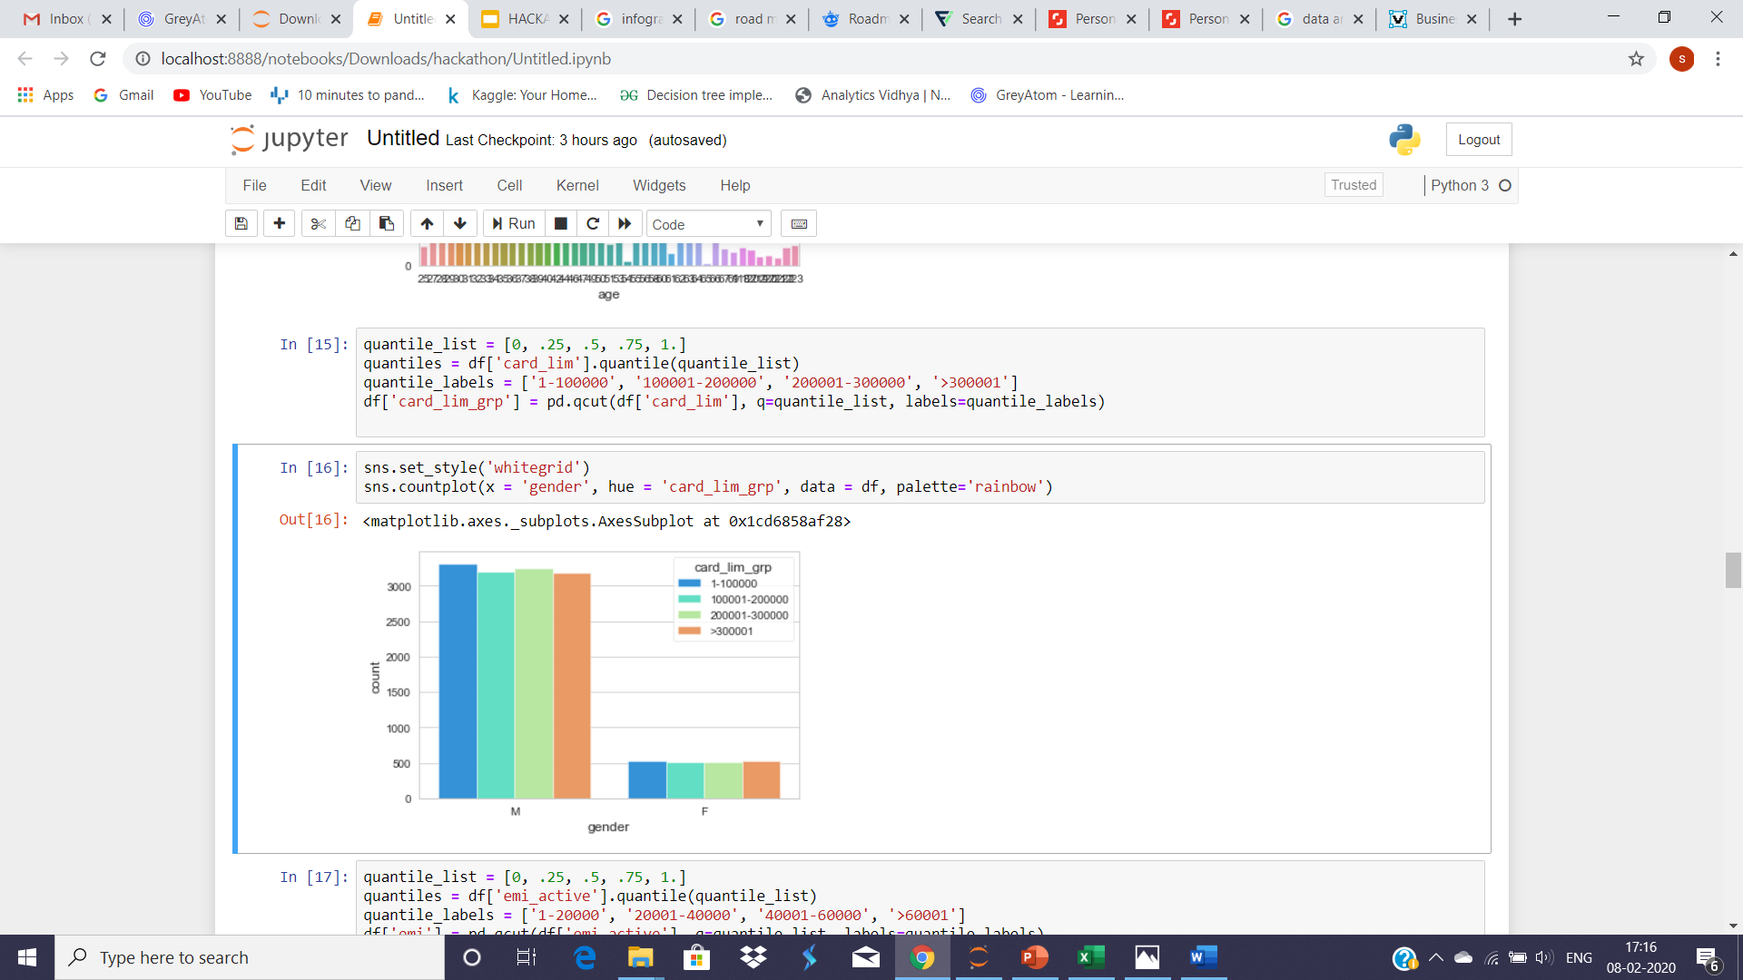
Gender based Card Limits

Slide 10
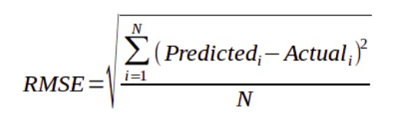
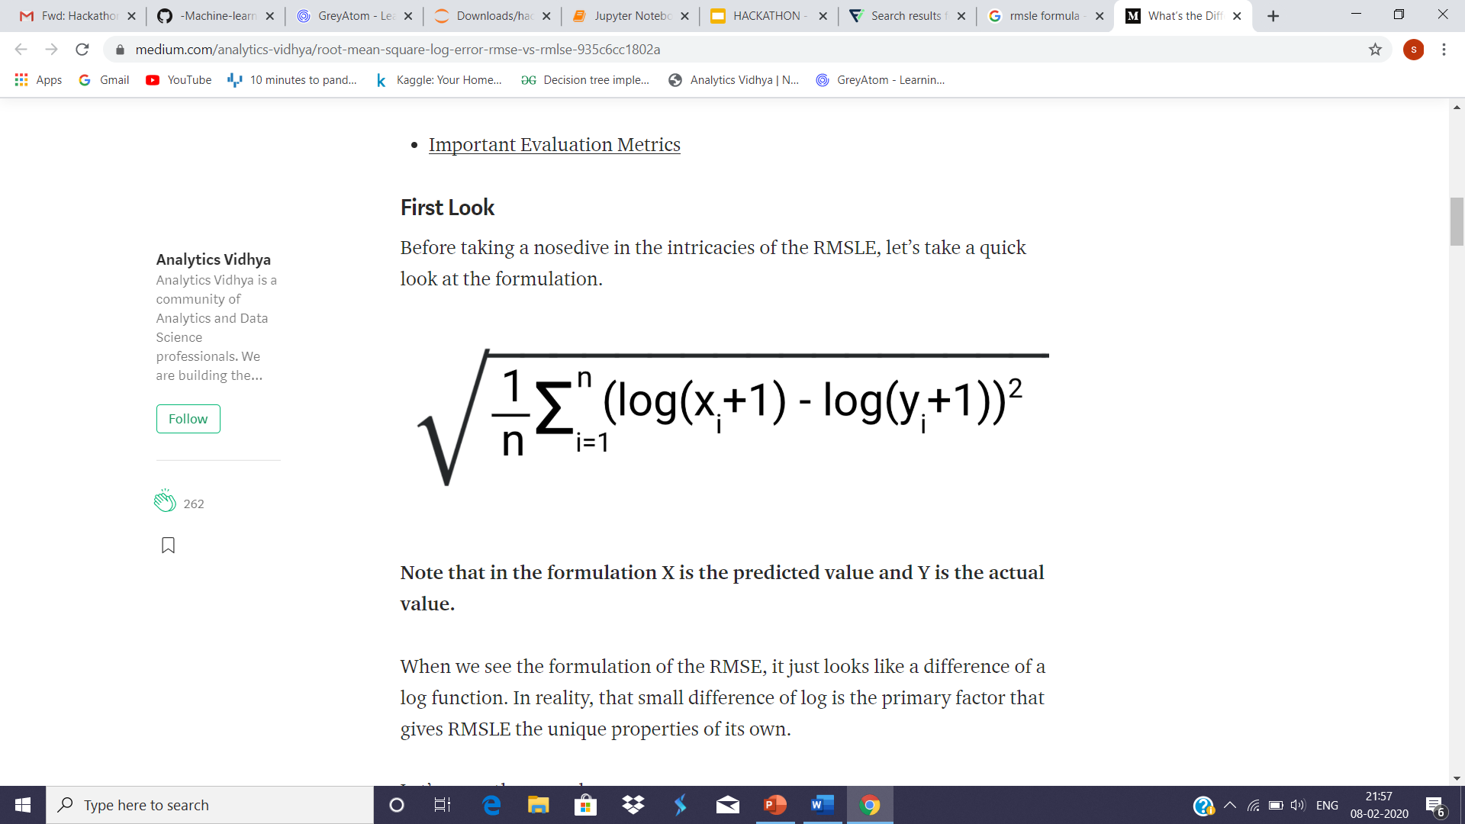
Evaluation Method Used
RMSE (Root Mean Square Error):
RMSLE (Root Mean Squared Log Error)
Notes:
Ratio between the actual and predicted values. It can be used when you don’t want to penalize huge differences when both the values are huge numbers.

Slide 11
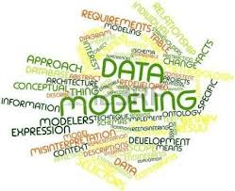
Models Used
Linear Regression with all variables
Lasso Regression with all variables
Ridge regression with all variables
Decision Trees with all variables
Linear Regression with feature selection
Random Forest with feature selection

Slide 12
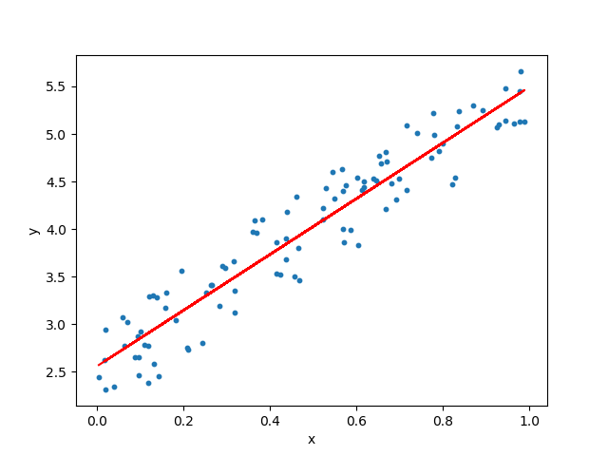
Linear Regression
Linear Regression is a supervised learning algorithm.
It is used to determine relationship between dependent variable and one or more independent variables.

Slide 13
Lasso and Ridge Regression
•Ridge or lasso are forms of regularized linear regressions
•Ridge and Lasso regression are some of the simple techniques to reduce model complexity and prevent overfitting which may result from simple linear regression
•Lasso is a method of adjusting the parameters in a regression to account for the complexity of the model. Ridge regression is a biased method of regression that reduces the variance of the estimators.

Slide 14
Decision Trees
•Decision Tree is a decision-making tool that uses a flowchart-like tree structure or is a model of decisions and all of their possible results
•Decision trees regression normally use mean squared error (MSE) to decide to split a node in two or more sub-nodes.

Slide 15
Feature Selection
•Feature selection is the process of choosing variables that are useful in predicting the response (Y).
•The Recursive Feature Elimination (RFE) method works by recursively removing attributes and building a model on those attributes that remain. It uses accuracy metric to rank the feature according to their importance. The RFE method takes the model to be used and the number of required features as input.

Slide 16
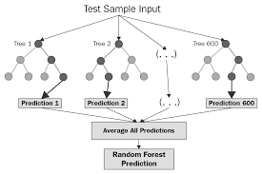
Random Forest
Supervised Learning Algorithm works for both Regression and Classification . Part of sklearn.ensemble package.
It is mostly preferred over Decision Trees
It is type of Ensemble Learning
Approaches:
Tried simple Random Forest
Used RandomizedSearchCV and found best parameters and fine tuned out Random Forest Model
Notes:
The random forest is a model made up of many decision trees. When training, each tree in a random forest learns from a random sample of the data points.

Slide 17
Model Comparison
Models | Train RMSE | Test RMSE | Platform Result
Multiple Linear Regression | 1.6078 | 1.6146 | 1.612
Lasso Regularization | 1.6014 | 1.6123 | 1.6120
Ridge Regularization | 1.6077 | 1.6152 | 1.6127
Decision Tree | 1.6104 | 1.6123 | 1.6104
Linear regression with Feature selection | 1.6089 | 1.6121 | 1.6113
Random Forest with Feature Selection | 1.6016 | 1.6138 | 1.6114

Slide 18

Business Insights
People having debit cards have spend more.
Bank needs to provide more offers to increase Credit Card usage.
Gender-wise Man has shown expense as compared to females.
As Females like to spend, Females concentric Marketing needs to be done
Current Account sees more expenditure, but might be due to cash flows.
In short, Marketing Campaign for Females and some special promotion for credit card to increase usage of credit card Age(20-35)

Slide 19
If more time was provided..
If more time was provided we would’ve tried another model for Lower RMSLE score, they are:
XGBoost: XGBoost is an implementation of gradient boosted decision trees designed for speed and performance that is dominative competitive machine learning
PCA: It turns possible correlated features into a set of linearly uncorrelated ones called ‘Principal Components’.
Ensemble models can also be used for combining multiple models to improve the accuracy using bagging, boosting.

Slide 20
THANK YOU !!

